Slide 1

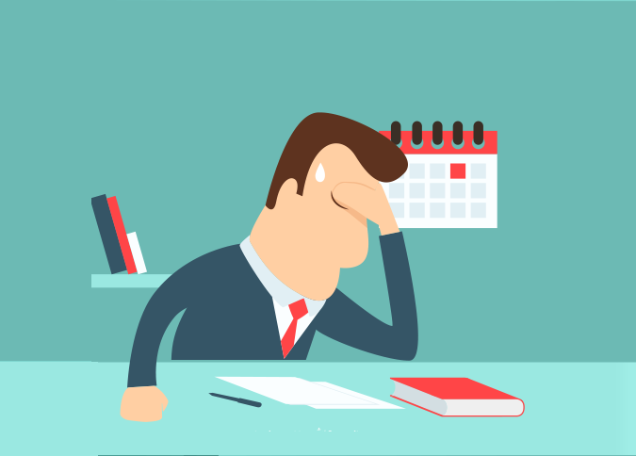

LEAD Myself
Personal Effectiveness –
Managing Stress

Slide 2
LEAD Myself
LEAD MYSELF - PERSONAL EFFECTIVENESS
 | Pre-workshop study | Programme Objectives
Awareness and management of self and others | Managing your time strategically | To optimise the relationship between efficiency and effort To prioritise events according to their level of importance
 | Clarifying and managing your priorities | To identify obstacles to excellent time management
 | Understand how you deal with stress | To identify how you deal with stress and its consequences on the organisation and your work
 | Knowing yourself better to communicate better | To develop self-knowledge for better communication
Notes:
Need to check review these.

Slide 3
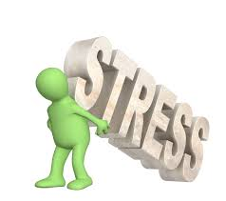
LEAD Myself – Managing Stress
What is Stress?
"a condition or feeling experienced when a person perceives that demands exceed the personal and social resources the individual is able to mobilize.”
This means that we experience stress if we believe that we don't have the time, resources, or knowledge to handle a situation. In short, we experience stress when we feel "out of control.”
This also means that different people handle stress differently, in different situations: you'll handle stress better if you're confident in your abilities, if you can change the situation to take control, and if you feel that you have the help and support needed to do a good job.
Notes:
Need to check review these.

Slide 4
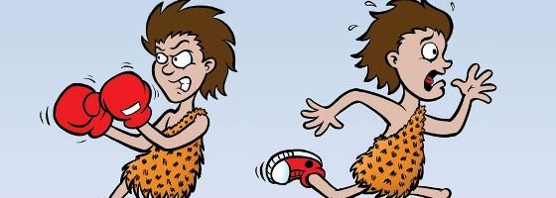
LEAD Myself – Managing Stress
Reactions to stress
1. Flight or flight
a basic, short-term survival response, which is triggered when we experience a shock, or when we see something that we perceive as a threat.
Our brains then release stress hormones that prepare the body to either "fly" from the threat, or "fight" it. This energizes us, but it also makes us excitable, anxious, and irritable.
The problem with the fight or flight response is that, although it helps us deal with life-threatening events, we can also experience it in everyday situations – for example, when we have to work to short deadlines, when we speak in public, or when we experience conflict with others.
In these types of situations, a calm, rational, controlled, and socially-sensitive approach is often more appropriate.
Notes:
Need to check review these.

Slide 5
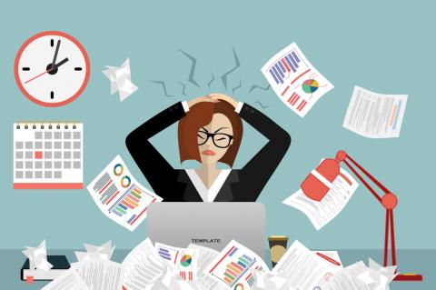
LEAD Myself – Managing Stress
Reactions to stress
2. General Adaptation Syndrome (GAS)
GAS, which Hans Selye identified in 1950, is a response to long-term exposure to stress.
Selye found that we cope with stress in three distinct phases:
The alarm phase, where we react to the stressor.
The resistance phase, where we adapt to, and cope with, the stressor. The body can't keep up resistance indefinitely, so our physical and emotional resources are gradually depleted.
The exhaustion phase, where, eventually, we're "worn down" and we cannot function normally.
Notes:
Need to check review these.

Slide 6

LEAD Myself – Managing Stress
Fight or flight and GAS are actually linked – the exhaustion phase of GAS comes from an accumulation of very many fight or flight responses, over a long period of time.
Notes:
Need to check review these.

Slide 7
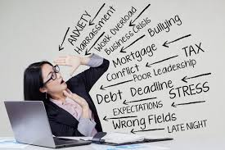
LEAD Myself – Managing Stress
Signs of Stress
Everyone reacts to stress differently. However, some common signs and symptoms of the fight or flight response include:
Frequent headaches.
Cold or sweaty hands and feet.
Frequent heartburn, stomach pain, or nausea.
Panic attacks.
Excessive sleeping, or insomnia.
Persistent difficulty concentrating.
Obsessive or compulsive behaviours.
Social withdrawal or isolation.
Constant fatigue.
Irritability and angry episodes.
Significant weight gain or loss.
Consistent feelings of being overwhelmed or overloaded.
Notes:
Need to check review these.

Slide 8
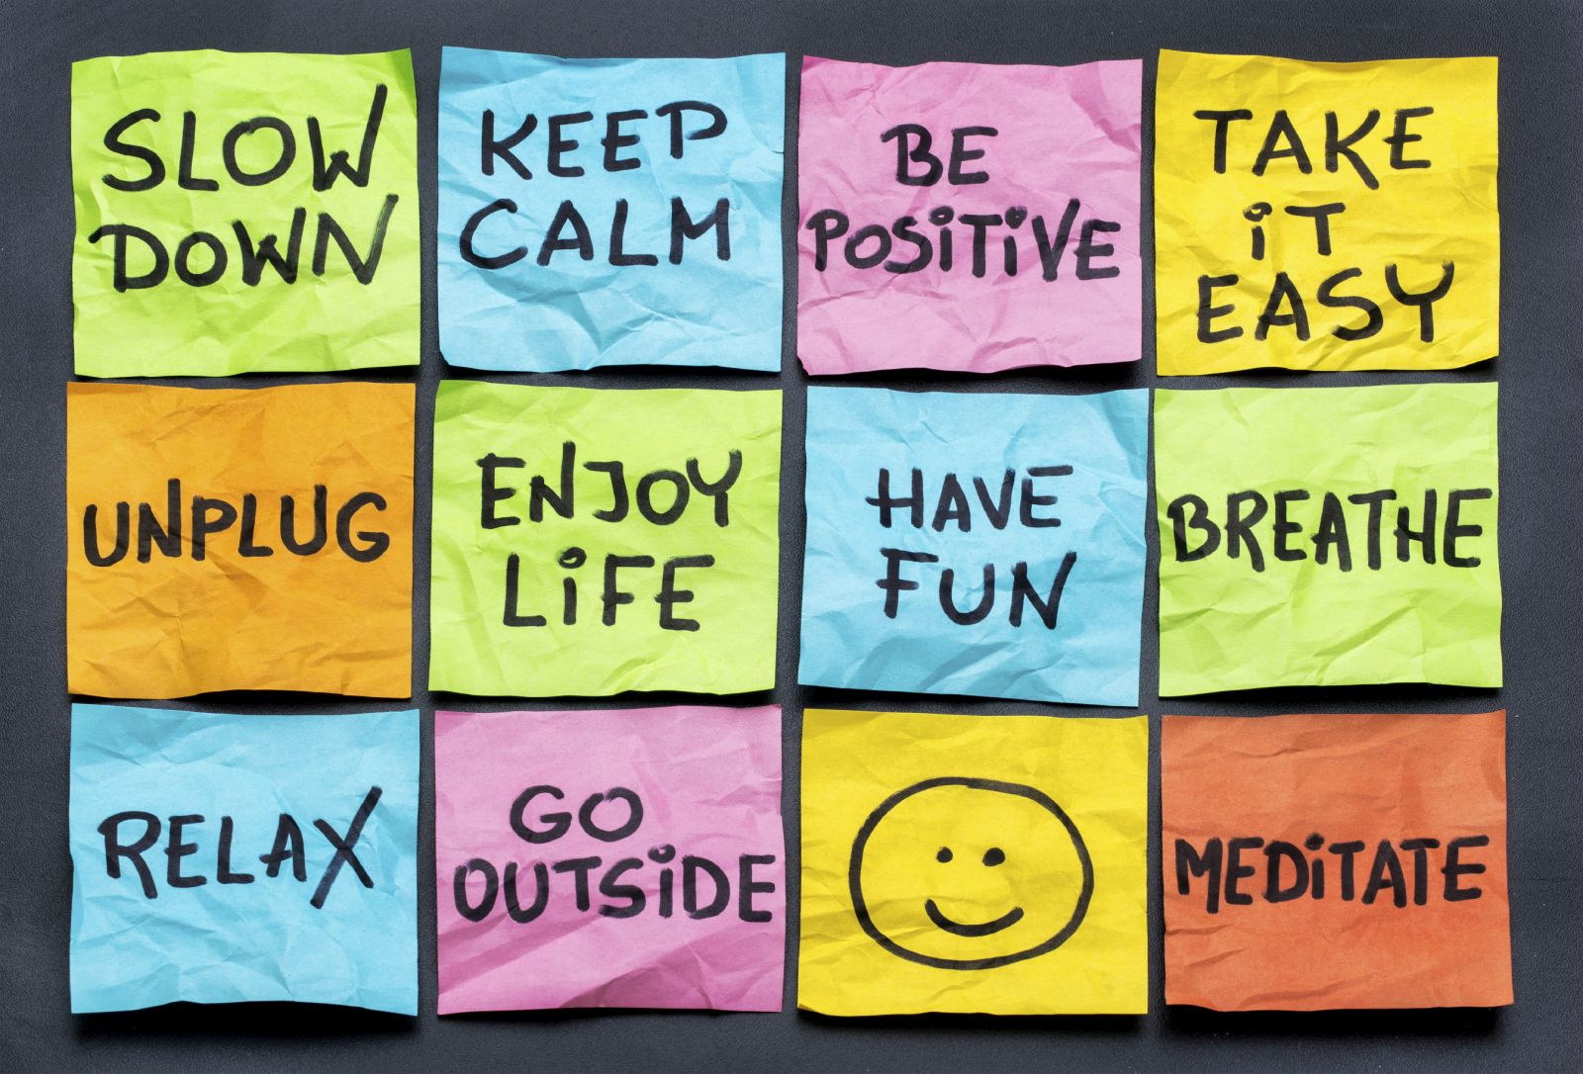
LEAD Myself – Managing Stress
How to Manage Stress
Action-oriented approaches
Managing your time
Managing other people
Managing your working environment
2. Emotion-oriented approaches
Change how you think about stressful situations
Overcome short-term negative thinking, so that you feel more positive about stressful situations.
Notes:
Need to check review these.

Slide 9
LEAD Myself – Managing Stress
How to Manage Stress
3. Acceptance Oriented Approaches
Apply to situations where you have no power to change what
happens, and where situations are genuinely bad.
Build your defenses against stress:
Use techniques like meditation
and physical relaxation to calm yourself when you feel stressed.
Take advantage of your support network – this could include your friends and family, as well as people at work and professional providers, such as counselors or family doctors.
Get enough exercise and sleep, and learn how to make the most of your down time, so that you can recover from stressful events. Learn how to cope with change and build resilience, so that you can overcome setbacks.
Notes:
Need to check review these.

Slide 10

LEAD Myself – Managing Stress
Taking Action
Identifying Your Triggers
Managing accessibility at work
Managing Interactions at work
Managing your time at work
Making positive personal choices
Starting with small steps
Watch videos on Managing Stress by Tom Dewett (21 mins)
Notes:
Need to check review these.

Slide 11
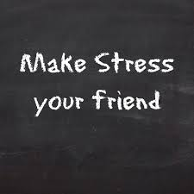
LEAD Myself – Managing Stress
Rethinking the Way We Look at Stress
A study tracking 30,000 adults in the United States for eight years found that those who experienced a lot of stress and also believed that stress was harmful for their health had a 43 percent increased risk of dying. But people who experienced a lot of stress and did not believe stress was harmful had the lowest risk of dying of anyone in the study, including people who had relatively little stress
This study suggests that changing the way you think about stress can change your body’s response to stress.
Research suggests if you view your body’s stress response as helpful for your performance, rather than as signs you are not coping well, you are likely to be less anxious, more confident, and your physical stress response may change.
Notes:
Need to check review these.

Slide 12
LEAD Myself – Managing Stress
Rethinking the Way We Look at Stress
Often a stress response means your heart rate increases and your blood vessels constrict. This is not healthy. But when you view your stress response as helpful, your blood vessels may stay relaxed and you heart maintains a healthier state, similar to what happens when you experience moments of joy and courage. So the new science of stress suggests that how you think about stress does matter.
Stress can also make you social through the release of the hormone – oxytocin. Known as the cuddle hormone it encourages you to reach out to family and friends to tell them how you feel, to be more compassionate for others, and be more willing to help and support the people you care about.
Oxytocin also protects and heals your cardiovascular system from the effects of stress. And the more you reach out to others, either for support or to offer help, the more oxytocin you release, and the healthier your stress response will be.
Research has also found that spending time helping out friends, neighbors or people in your community can create resilience to the health risks of stress.
Notes:
Need to check review these.

Slide 13
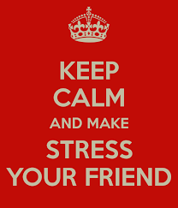
LEAD Myself – Managing Stress
Watch How to Make Stress Your Friend – Watch TedTalk Video – by Kelly McGonigal (14mins)
https://www.ted.com/talks/kelly_mcgonigal_how_to_make_stress_your_friend
Notes:
Need to check review these.

